Slide 1
CSE514 – Datamining Fall 2022 Performance Metrics
Cynthia Ma
Department of Computer Science
Washington University in St. Louis
czma@wustl.edu

Slide 2
Quick admin follow-up
Lecture recordings
First week’s lecture recordings are links on Canvas
Last Wednesday’s “end clip” also on Canvas
TA office hours added
Mondays, 7-8:30pm with Di and Marvin
Tuesdays, 6:30-8:30pm with Talal and Wenyu
Programming assignment 1
If your error grows to infinity, try a smaller learning rate

Slide 3
What makes a learned model “good”?
Goal 1:
We want to define a model that fits our data with minimal error
Goal 2:
We want to define a model that explains the processes that generated the data
Goal 3:
We want to define a model that can predict the response/label of new data

Slide 4
Minimizing error
Intuitively, it seems like a good thing to learn a model that fits the data perfectly
Fairly easy goal since
less error = improvement
Examples from lecture so far?
Possible problems with this goal?

Slide 5
Application to programming assignment 1
Data set has 1030 instances, separated so that
900 randomly selected samples is the training set
130 remaining samples cannot be used for training your models in any way!
You should use gradient descent to increase variance explained
You can use cross-validation to tune hyperparameters
Ex. The gradient descent stopping threshold

Slide 6
Learning generalizable models
Given a dataset:
What processes created this data?
What do I predict for the future from this data?
Minimize error on unseen data
If the model we learned can perform just as well on data it’s never seen before, it’s probably learned true relationships and can continue to perform well on future data
i.e. Cross Validation

Slide 7
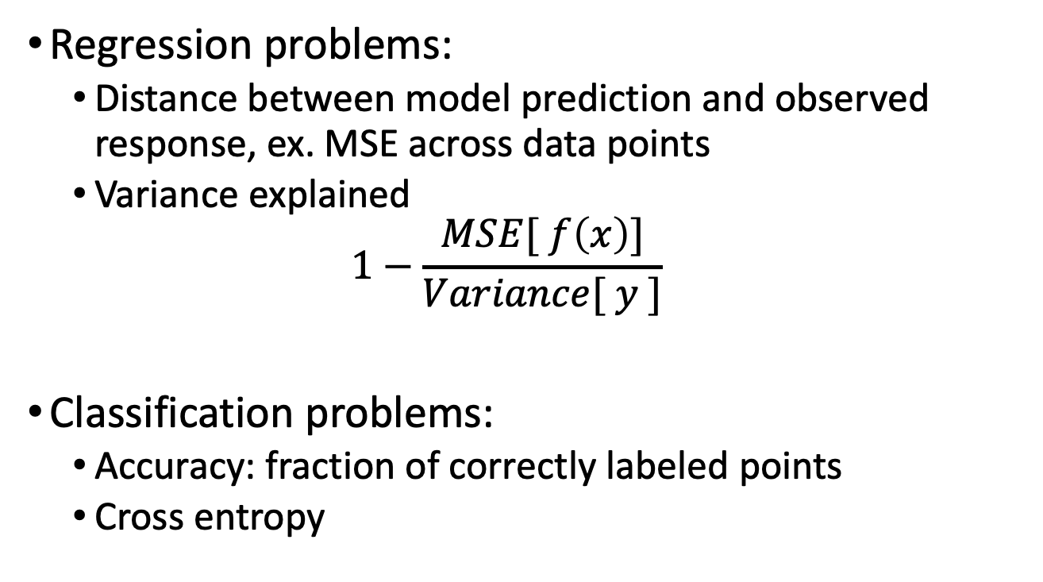
Evaluation of accuracy
Regression problems:
Distance between model prediction and observed response, ex. MSE across data points
Variance explained
$$1−\frac{MSE[ f\left(x\right)]}{Variance[ y ]}$$
Classification problems:
Accuracy: fraction of correctly labeled points
Cross entropy

Slide 8
Confusion Matrix for Binary Classification
Observed positive (P)
Observed negative (N)
True positive rate (TPR)
i.e. Sensitivity
TP / (TP + FN)
True negative rate (TNR)
i.e. Specificity
TN / (TN + FP)
Type I error = FP
Mistaken rejection of the null hypothesis
Type II error = FN
Mistaken acceptance of the null hypothesis
True Positive
(TP)
False Positive
(FP)
Predicted positive (P’)
False Negative
(FN)
True Negative
(TN)
Predicted negative (N’)

Slide 9
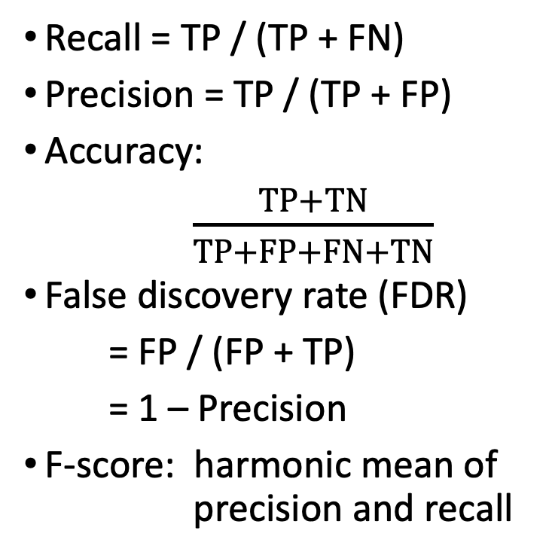
Confusion Matrix for Binary Classification
Observed positive (P)
Observed negative (N)
Recall = TP / (TP + FN)
Precision = TP / (TP + FP)
Accuracy:
$\frac{TP+TN}{TP+FP+FN+TN}$
False discovery rate (FDR)
= FP / (FP + TP)
= 1 – Precision
F-score: harmonic mean of precision and recall
True Positive
(TP)
False Positive
(FP)
Predicted positive (P’)
False Negative
(FN)
True Negative
(TN)
Predicted negative (N’)
Notes:
Arithmetic mean = (x+y)/2
Geometric mean = (x*y)^(1/2)
Harmonic mean = (2xy)/(x+y)

Slide 10
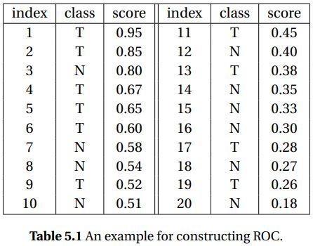
Binary classification on a continuous model
Some classifiers output probabilities or confidence scores that a data point is positive
There may not be a
one-size fit all threshold
Ex. Google search results
Ex. Disease diagnosis

Slide 11
Receiver Operating Characteristic (ROC)
Plots the false positive rate of the model (x-axis) against the true positive rate (y-axis)
Why?
As we loosen thresholds so that the model doesn’t miss positive predictions, we risk gaining FP in exchange for gaining TP
For “good” models, we expect this exchange to skew towards gaining more TP than FP
The area under the ROC curve (AUROC) is higher for “good” models

Slide 12
Precision-Recall (PR)
Plots the recall of the model (x-axis) against the precision (y-axis)
Why?
As we tighten thresholds so that the model more precisely labels positive data points, we risk failing to recall all the positive data points
For “good” models, we expect this exchange to skew towards gaining more precision than we loose recall
The area under the PR curve (AUPR) is higher for “good” models

Slide 14
ROC vs PR
FPR = FP / (FP + TN)
= 1 – TN / (FP + TN)
= 1 - Specificity
ROC is TPR vs FPR
PR is precision vs recall
Recall = TPR = TP / ( TP + FN )
So when to use ROC (w/ FPR) vs. PR (w/ precision)?
Depends on which metric is more relevant to your problem
Depends on how balanced your dataset is between positive and negative examples

Slide 15
Extending beyond binary classification
What if we’re doing multi-class classification?
Accuracy is still fraction of classification predictions that are correct
All other metrics become class specific
Pick a class to be your “positive” class
All other classes are treated as the “negative”
Calculate with this simplified confusion matrix

Slide 16
Evaluation of accuracy
Regression problems:
Distance between model prediction and observed response, ex. MSE across data points
Variance explained
$$1−\frac{MSE[ f\left(x\right)]}{Variance[ y ]}$$
Classification problems:
Accuracy: fraction of correctly labeled points
Cross entropy

Slide 17
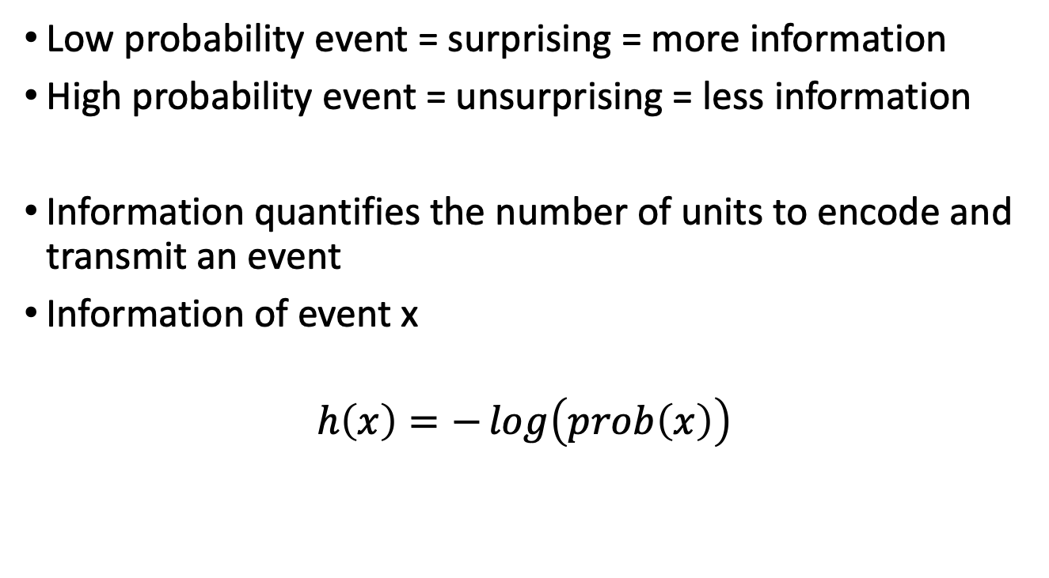
Information Theory detour…
Low probability event = surprising = more information
High probability event = unsurprising = less information
Information quantifies the number of units to encode and transmit an event
Information of event x
$$h\left(x\right)=−\log\left(prob\left(x\right)\right)$$
Notes:
Log base e units are nats
Log base 10 units are dits, bans, or hartleys

Slide 18
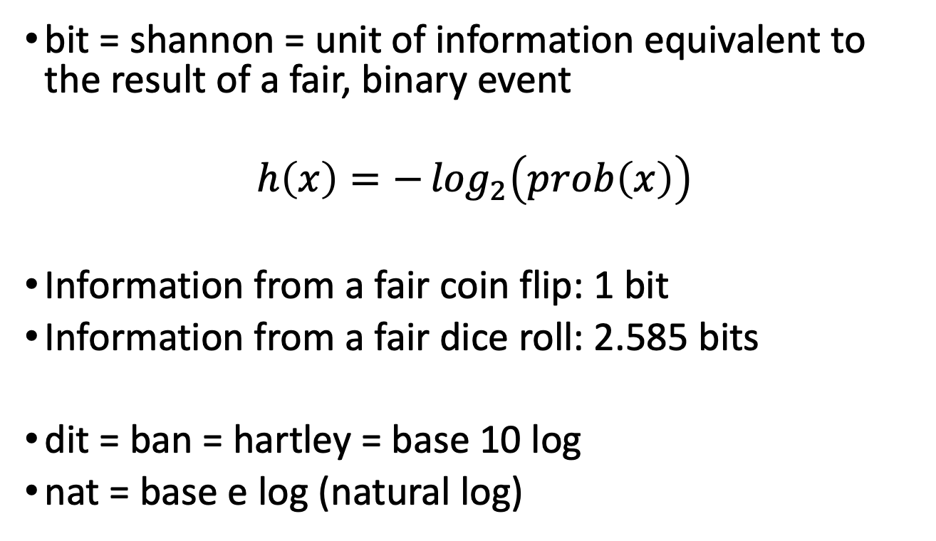
Information in bits
bit = shannon = unit of information equivalent to the result of a fair, binary event
$$h\left(x\right)=−\log_{2}\left(prob\left(x\right)\right)$$
Information from a fair coin flip: 1 bit
Information from a fair dice roll: 2.585 bits
dit = ban = hartley = base 10 log
nat = base e log (natural log)

Slide 19
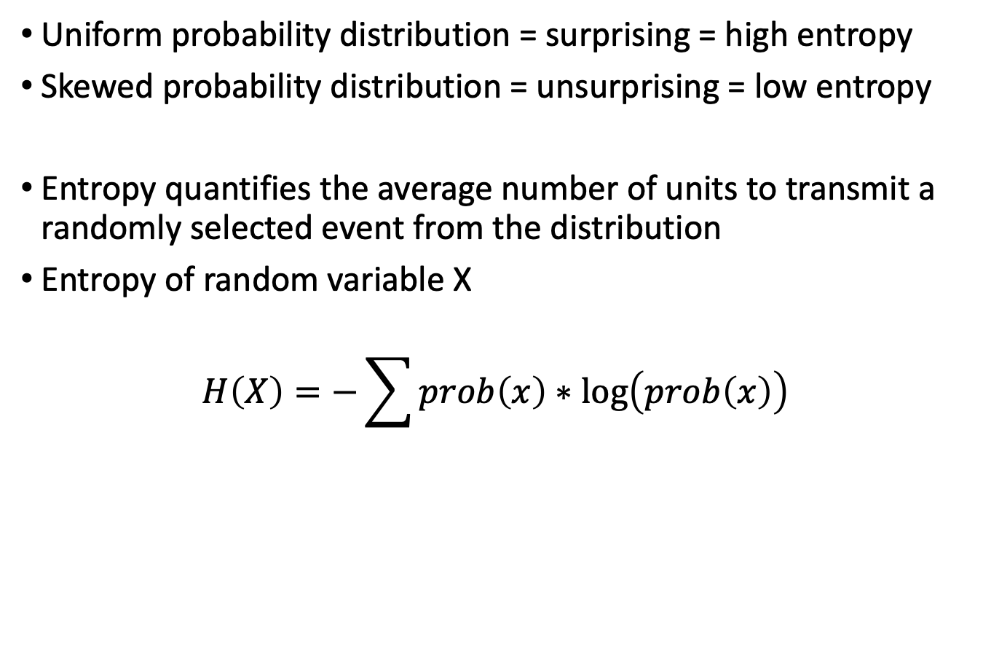
From events to distributions
Uniform probability distribution = surprising = high entropy
Skewed probability distribution = unsurprising = low entropy
Entropy quantifies the average number of units to transmit a randomly selected event from the distribution
Entropy of random variable X
$$H\left(X\right)=−\sum{prob\left(x\right)∗\log\left(prob\left(x\right)\right)}$$

Slide 20
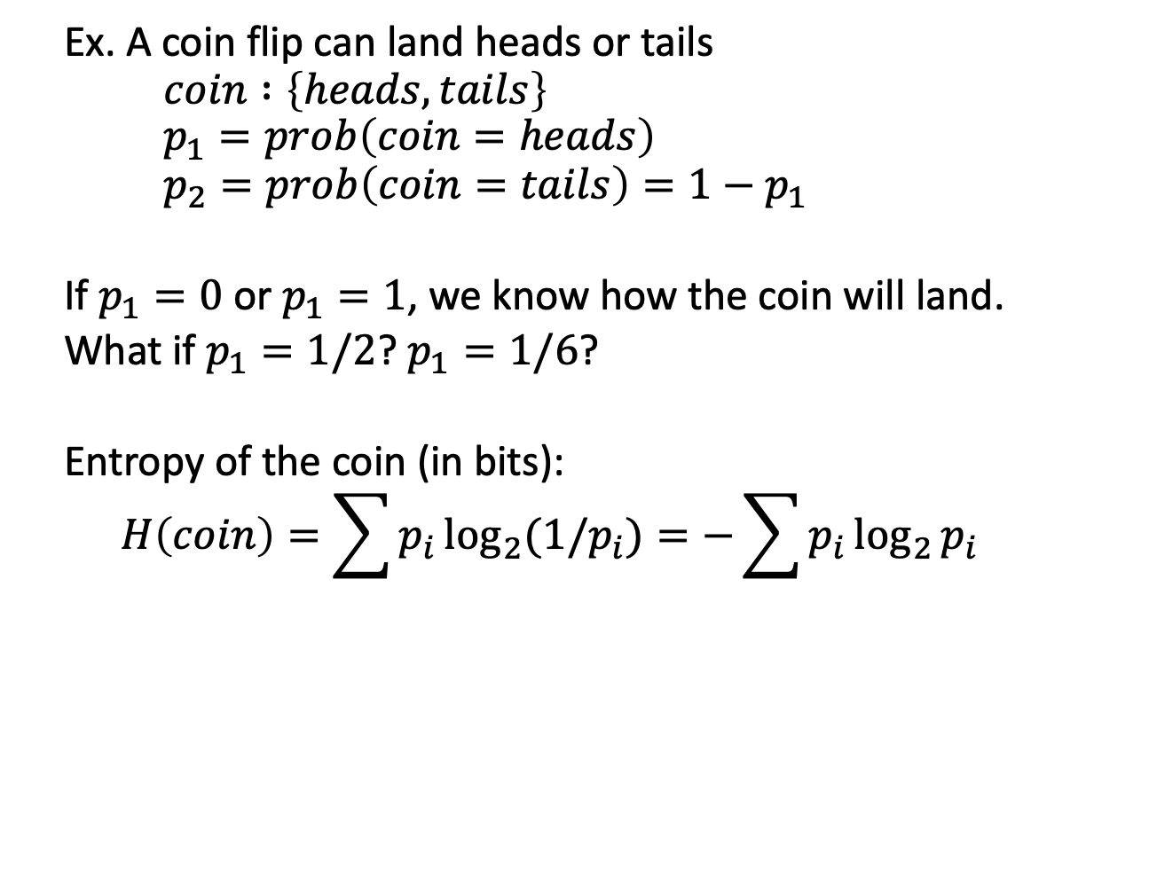
Entropy example
Ex. A coin flip can land heads or tails
$$coin :\left\{heads, tails\right\}$$
$$p_{1}=prob\left(coin=heads\right)$$
$$p_{2}=prob\left(coin=tails\right)=1−p_{1}$$
If $p_{1}=0$ or $p_{1}=1$, we know how the coin will land.
What if $p_{1}=1/2$? $p_{1}=1/6$?
Entropy of the coin (in bits):
$$H\left(coin\right)=\sum{p_{i}\log_{2}{(1/p_{i})}}=−\sum{p_{i}\log_{2}{p_{i}}}$$

Slide 21
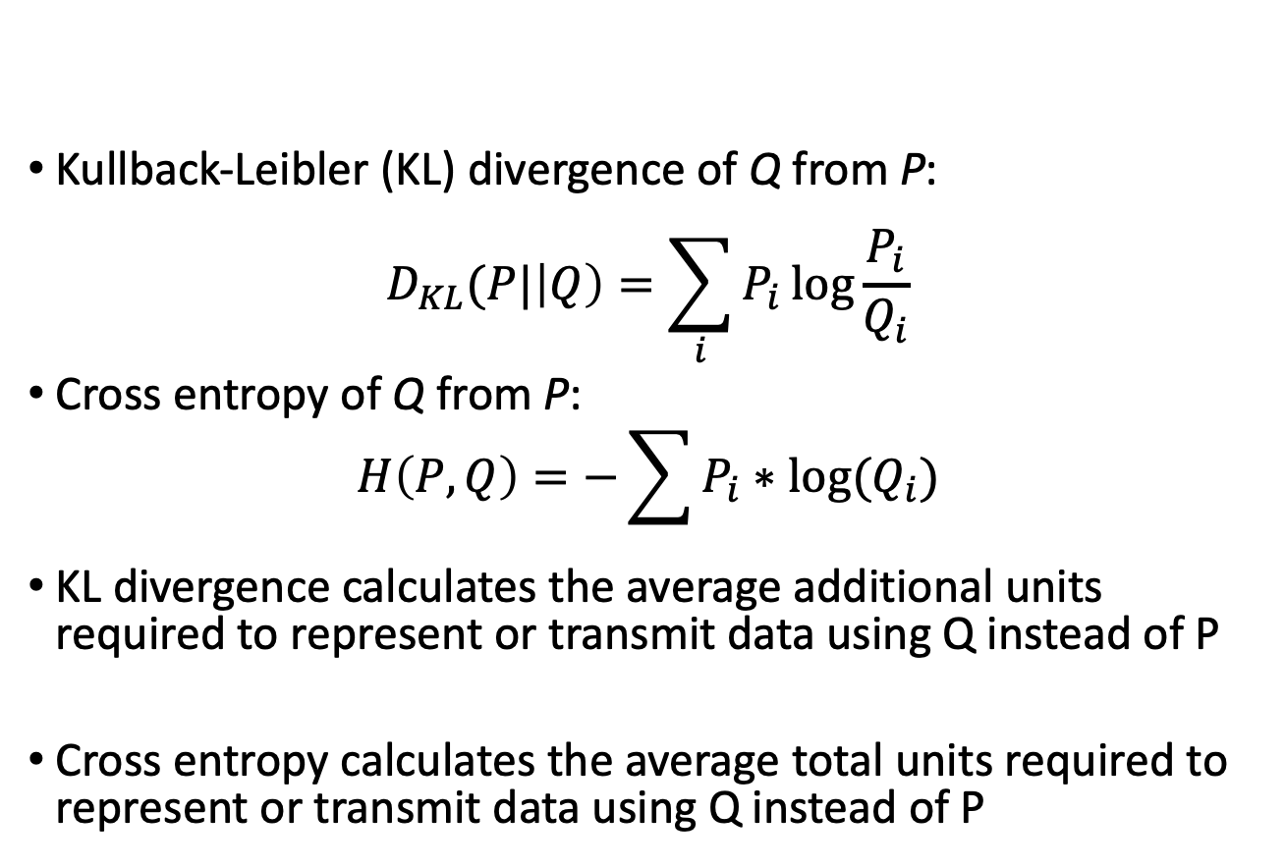
Measuring a difference in entropy
Kullback-Leibler (KL) divergence of Q from P:
$$D_{KL}(P|\left|Q\right)=\sum_{i}{P_{i}\log{\frac{P_{i}}{Q_{i}}}}$$
Cross entropy of Q from P:
$$H\left(P,Q\right)=−\sum{P_{i}∗log⁡(Q_{i})}$$
KL divergence calculates the average additional units required to represent or transmit data using Q instead of P
Cross entropy calculates the average total units required to represent or transmit data using Q instead of P

Slide 22
Review
A “good” model is a model that can generalize beyond the scope of its seen data
Confusion Matrix
AUROC vs AUPR
Entropy

Slide 23
Homework
Programming assignment 1 due October 12
You should have 8 univariate models, one per feature
For full credit, I expect variance explained on training data to be >10% for two of your univariate models, and your multivariate model
HW0 deadline is midnight Wednesday, Sept 14
HW 1 late deadline is midnight tomorrow, Sept 13
Piazza enrollment

